Slide 1

Dijkstra’s Algorithm
Discrete Maths is lit
🔥
Dylan Blecher, COMP2521
From a start node, find the shortest path to ALL other nodes ☺

Slide 2
We’ll go from 0

Slide 3
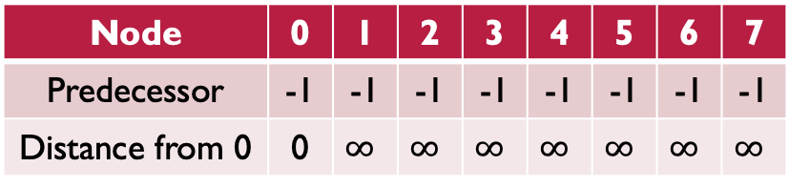
Initialisation
Unvisited nodes: 0 1 2 3 4 5 6 7
Node | 0 | 1 | 2 | 3 | 4 | 5 | 6 | 7
Predecessor | -1 | -1 | -1 | -1 | -1 | -1 | -1 | -1
Distance from 0 | 0 | $$∞$$ | $$∞$$ | $$∞$$ | $$∞$$ | $$∞$$ | $$∞$$ | $$∞$$

Slide 4
Current node: 0
Unvisited nodes: 0 1 2 3 4 5 6 7
Node | 0 | 1 | 2 | 3 | 4 | 5 | 6 | 7
Predecessor | -1 | -1 | -1 | -1 | -1 | -1 | -1 | -1
Distance from 0 | 0 | $$∞$$ | $$∞$$ | $$∞$$ | $$∞$$ | $$∞$$ | $$∞$$ | $$∞$$

Slide 5
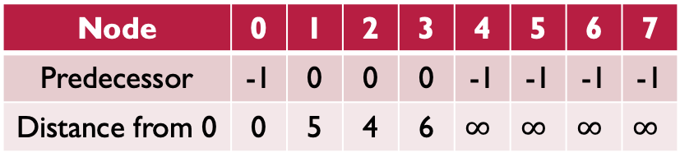
Current node: 0
Unvisited nodes: 0 1 2 3 4 5 6 7
Node | 0 | 1 | 2 | 3 | 4 | 5 | 6 | 7
Predecessor | -1 | 0 | 0 | 0 | -1 | -1 | -1 | -1
Distance from 0 | 0 | 5 | 4 | 6 | $$∞$$ | $$∞$$ | $$∞$$ | $$∞$$

Slide 6
Current node: 2
Unvisited nodes: 0 1 2 3 4 5 6 7
Node | 0 | 1 | 2 | 3 | 4 | 5 | 6 | 7
Predecessor | -1 | 0 | 0 | 0 | -1 | -1 | -1 | -1
Distance from 0 | 0 | 5 | 4 | 6 | $$∞$$ | $$∞$$ | $$∞$$ | $$∞$$

Slide 7
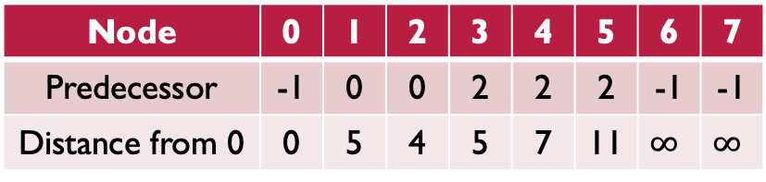
Current node: 2
Unvisited nodes: 0 1 2 3 4 5 6 7
Node | 0 | 1 | 2 | 3 | 4 | 5 | 6 | 7
Predecessor | -1 | 0 | 0 | 2 | 2 | 2 | -1 | -1
Distance from 0 | 0 | 5 | 4 | 5 | 7 | 11 | $$∞$$ | $$∞$$

Slide 8
Current node: 1
Unvisited nodes: 0 1 2 3 4 5 6 7
Node | 0 | 1 | 2 | 3 | 4 | 5 | 6 | 7
Predecessor | -1 | 0 | 0 | 2 | 2 | 2 | -1 | -1
Distance from 0 | 0 | 5 | 4 | 5 | 7 | 11 | $$∞$$ | $$∞$$

Slide 9
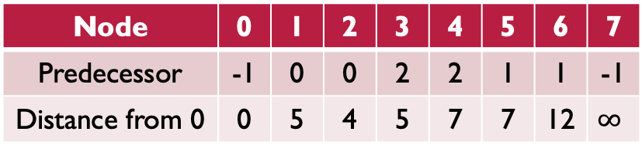
Current node: 1
Unvisited nodes: 0 1 2 3 4 5 6 7
Node | 0 | 1 | 2 | 3 | 4 | 5 | 6 | 7
Predecessor | -1 | 0 | 0 | 2 | 2 | 1 | 1 | -1
Distance from 0 | 0 | 5 | 4 | 5 | 7 | 7 | 12 | $$∞$$

Slide 10
Current node: 3
Unvisited nodes: 0 1 2 3 4 5 6 7
Node | 0 | 1 | 2 | 3 | 4 | 5 | 6 | 7
Predecessor | -1 | 0 | 0 | 2 | 2 | 1 | 1 | -1
Distance from 0 | 0 | 5 | 4 | 5 | 7 | 7 | 12 | $$∞$$

Slide 11
Current node: 4
Unvisited nodes: 0 1 2 3 4 5 6 7
Node | 0 | 1 | 2 | 3 | 4 | 5 | 6 | 7
Predecessor | -1 | 0 | 0 | 2 | 2 | 1 | 1 | -1
Distance from 0 | 0 | 5 | 4 | 5 | 7 | 7 | 12 | $$∞$$

Slide 12
Current node: 4
Unvisited nodes: 0 1 2 3 4 5 6 7
Node | 0 | 1 | 2 | 3 | 4 | 5 | 6 | 7
Predecessor | -1 | 0 | 0 | 2 | 2 | 1 | 1 | 4
Distance from 0 | 0 | 5 | 4 | 5 | 7 | 7 | 12 | 15

Slide 13
Current node: 5
Unvisited nodes: 0 1 2 3 4 5 6 7
Node | 0 | 1 | 2 | 3 | 4 | 5 | 6 | 7
Predecessor | -1 | 0 | 0 | 2 | 2 | 1 | 1 | 4
Distance from 0 | 0 | 5 | 4 | 5 | 7 | 7 | 12 | 15

Slide 14
Current node: 5
Unvisited nodes: 0 1 2 3 4 5 6 7
Node | 0 | 1 | 2 | 3 | 4 | 5 | 6 | 7
Predecessor | -1 | 0 | 0 | 2 | 2 | 1 | 5 | 5
Distance from 0 | 0 | 5 | 4 | 5 | 7 | 7 | 10 | 13

Slide 15
Current node: 6
Unvisited nodes: 0 1 2 3 4 5 6 7
Node | 0 | 1 | 2 | 3 | 4 | 5 | 6 | 7
Predecessor | -1 | 0 | 0 | 2 | 2 | 1 | 5 | 5
Distance from 0 | 0 | 5 | 4 | 5 | 7 | 7 | 10 | 13

Slide 16
Current node: 7
Unvisited nodes: 0 1 2 3 4 5 6 7
Node | 0 | 1 | 2 | 3 | 4 | 5 | 6 | 7
Predecessor | -1 | 0 | 0 | 2 | 2 | 1 | 5 | 5
Distance from 0 | 0 | 5 | 4 | 5 | 7 | 7 | 10 | 13

Slide 17
Done!
Unvisited nodes: 0 1 2 3 4 5 6 7
What’s the best route from 0 to 7?
0, 1, 5, 7
Node | 0 | 1 | 2 | 3 | 4 | 5 | 6 | 7
Predecessor | -1 | 0 | 0 | 2 | 2 | 1 | 5 | 5
Distance from 0 | 0 | 5 | 4 | 5 | 7 | 7 | 10 | 13

Slide 18
Pseudo-Code
While we haven’t visited all nodes
Choose current node to be the unvisited node with the smallest distance from start
Go through all unvisited neighbours of the current node
If the cost of getting to the neighbour is less than the stored amount
Update predecessor and distance

